Slide 1


Slide 2
Agenda
Software required
Angular Framework
Angular versioning
First Angular Application
Angular Components
Angular Modules
Angular Project Startup
Bootstrap Framework
First Angular Component
Angular Data binding

Slide 3
Software Required
NodeJS - It is a platform that allows us to run Javascript on our computer.
Javascript is a programming language originally created to run inside browsers.
NPM - It stands for Node Package Manager.
NPM is automatically installed with NodeJS.
It allows users to consume and distribute Javascript libraries from a remote repository. (https://www.npmjs.com/)
Angular CLI - It is a command-line interface tool used to initialize, develop, scaffold, and maintain Angular applications.
Visual Studio Code (VSC) - It is a source code editor.
Notes:
‹#›

Slide 4
Angular Framework
Angular is a Javascript framework that allows you to create reactive Single Page Applications (SPAs).
A SPA is single page in which, only by using javascript, we modify the HTML content without having to reach out to the server for each page change.
It's very fast and everything loads instantly. Because changing the page with Javascript is much faster than having to reach out to the server for every page change and for every piece of data you want to display.
If any data is needed from the server we just load it in the background so the user never leaves this experience of having a reactive web application to use.
Notes:
‹#›

Slide 5
Angular Versioning
Angular 1 was the first Angular version. Google released Angular 1 in October 2010 and it was the new big thing in front-end frameworks.
Although Angular 1 was the big thing, it had some issues that could lead into performance problems in big applications.
Angular 1 is frequently referred to as AngularJS because it was completely rewritten from the ground up to produce Angular 2 in 2016.
Angular 2 works entirely differently from Angular 1 as all the Angular 1 issues were fixed. After Angular 2, Google released Angular 4, 5, 6, and so on but them all are backwards-compatible to Angular 2.
The Angular team has a commitment to release a major new version every six months.
Notes:
‹#›

Slide 6
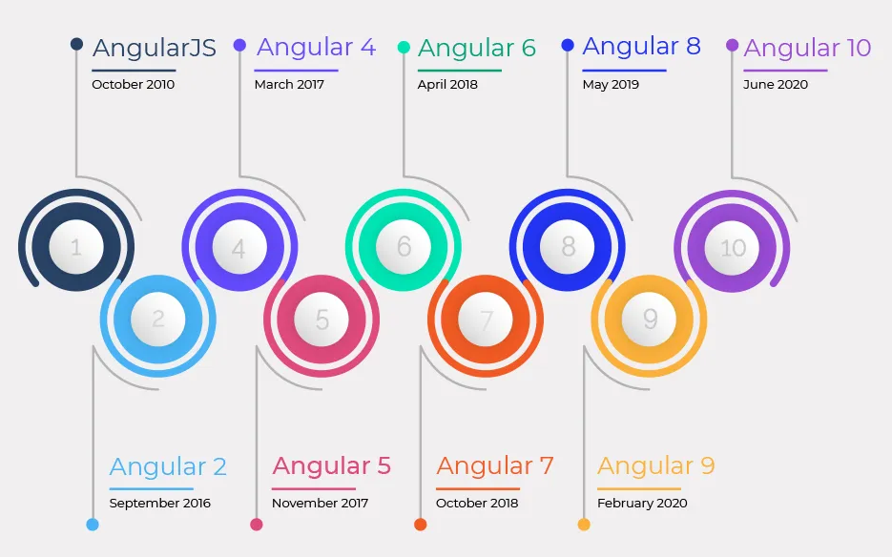
Angular Versioning
Notes:
‹#›

Slide 7
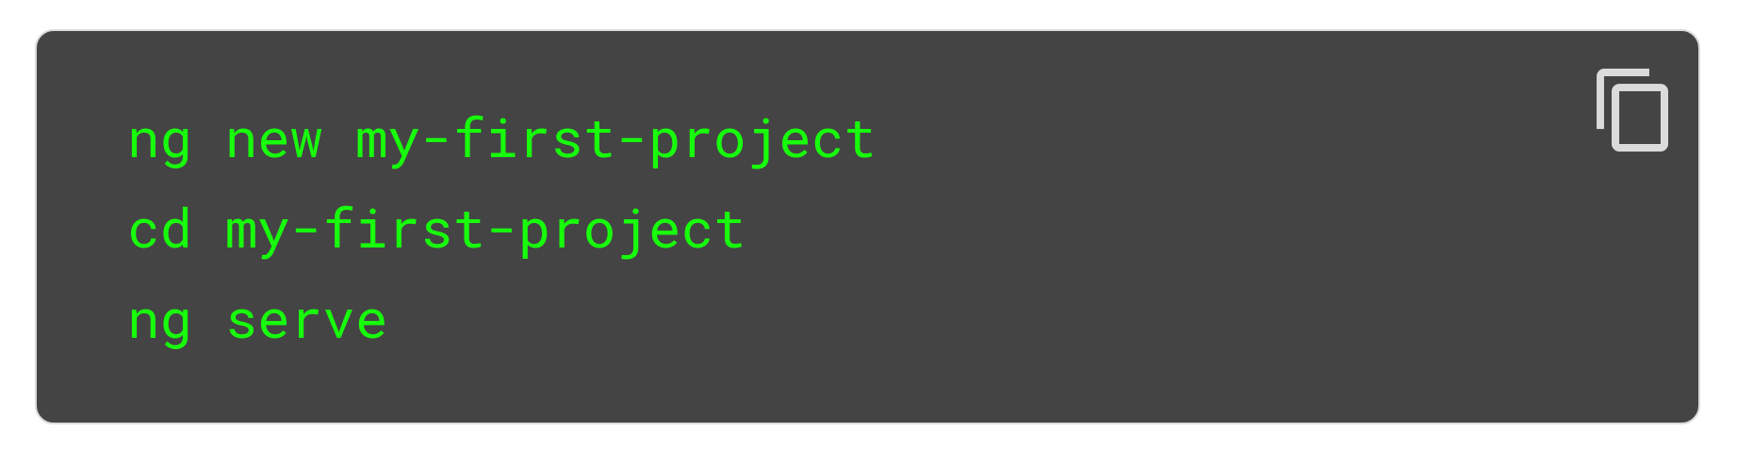
First Angular Application
To create, build, and serve a new basic Angular project on a development server, go to the parent directory of your new Angular workspace use the following commands:
In your browser, open http://localhost:4200/ to see the new application run. When you use the ng serve command to build an application and serve it locally, the server automatically rebuilds the application and reloads the page when you change any of the source files.
Notes:
https://angular.io/cli
‹#›

Slide 8
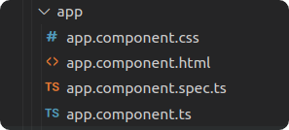
Angular Components
Components are the basic building block in Angular. The major part of the development is done in the components. Components are basically classes that interact with the .html file of the component, which gets displayed on the browser.
An Angular component consists of the following files:
A CSS style sheet.
An HTML template.
A Specs file used for testing.
A Typescript file for the business logic.
The App Component is the root component of the Angular application and ties together the whole application.
Notes:
‹#›

Slide 9
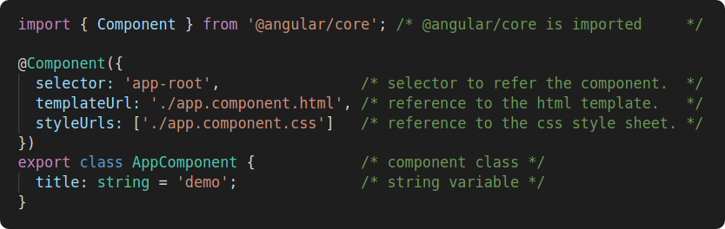
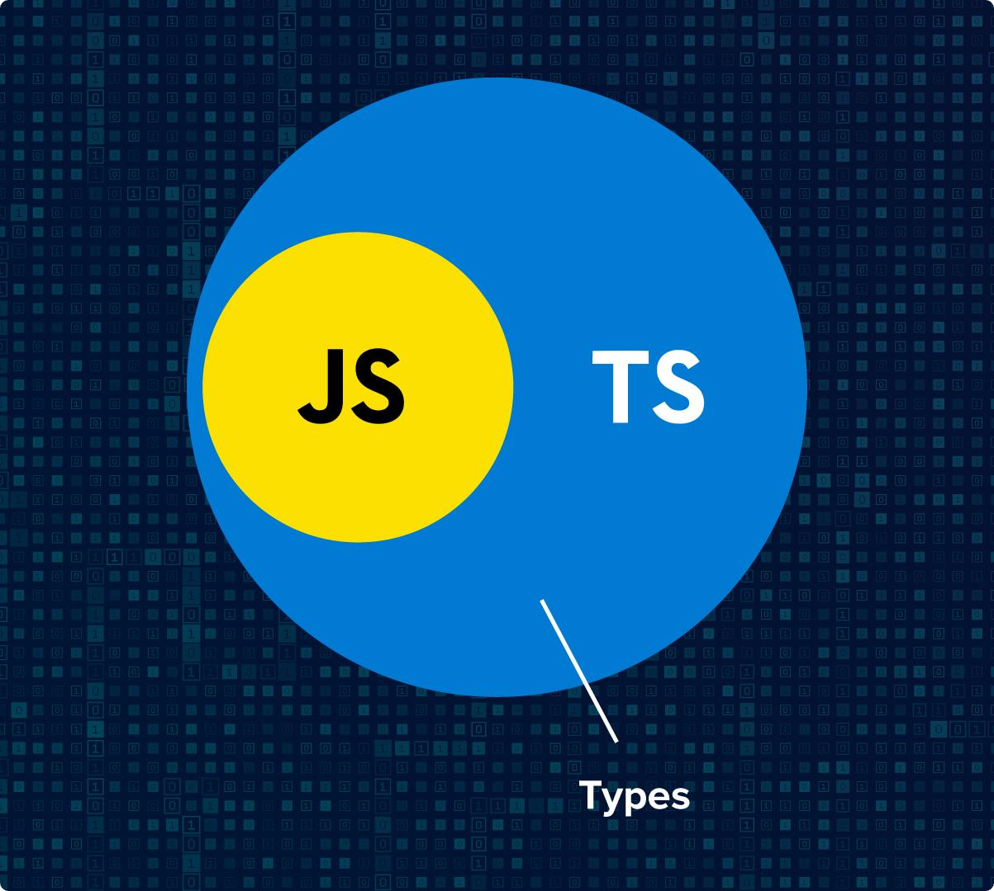
Angular Components
Angular Component Typescript file:
Angular Components are written in Typescript which is a Javascript superset. That is important because it makes the code more robust.
Typescript doesn’t run on the browser so that it needs to be compiled to Javascript. That is one of the reasons we need Angular CLI.
Typescript = Javascript + Classes + Interfaces + Data Types
Notes:
‹#›

Slide 10
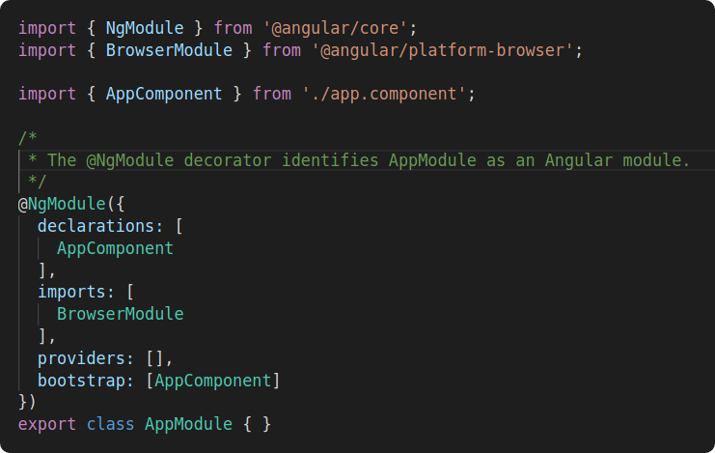
Angular Modules
An Angular module class describes how the application parts fit together. Every application has at least one Angular module, the root module that you bootstrap to launch the application. The conventional name is AppModule (app.module.ts).
Notes:
‹#›

Slide 11
Angular Modules
The @NgModule decorator identifies AppModule as an Angular module class (also called an NgModule class). @NgModule takes a metadata object that tells Angular how to compile and launch the application.
imports — This array contains the modules the application requires. Every application that runs in a browser needs the BrowserModule.
declarations — This array lists the Angular components that belong to the AppModule. As you create more components, you will add them to the declarations array.
bootstrap — This array lists the Angular components that will be created when the application is started. Most applications bootstrap a single boot component.
Notes:
‹#›

Slide 12
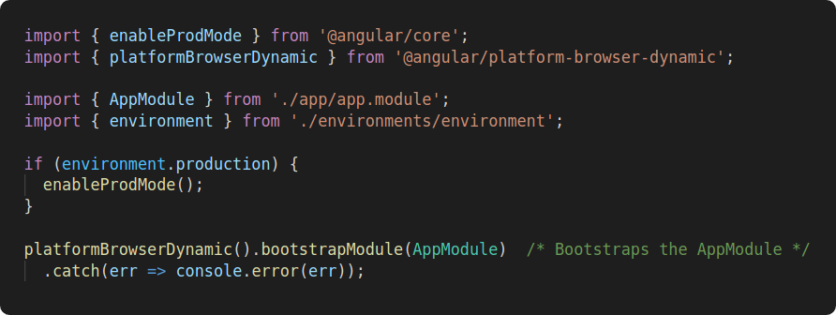
Angular main.ts
The main.ts file contains code that creates a browser platform for dynamic (JIT) compilation and bootstraps the AppModule described previously.
Notes:
‹#›

Slide 13
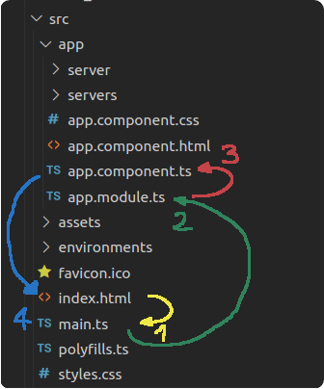
How is Angular Triggered?
After the index.html page is loaded in the browser, the following events sequence happens:
The index.html page calls the main.ts file.
The main.ts bootstraps the AppModule.
The AppModule bootstraps the AppComponent.
The AppComponent is placed in the index.html page.
Notes:
‹#›

Slide 14
Bootstrap Framework
It is a CSS framework that we can use to have some nice CSS styles out of the box. So we don't need to write all these styles.
We can install bootstrap into our project with the following steps:
Add bootstrap to the dependencies object of the package.json file.
"bootstrap": "^4.6.0",
Refresh your project’s dependencies.
npm install
Add bootstrap in the styles array of the angular.json file.
"styles": [ "node_modules/bootstrap/dist/css/bootstrap.min.css",
"src/styles.css" ],
Save the angular.json file and run the Angular project.
ng serve
Notes:
https://www.w3schools.com/bootstrap/bootstrap_ver.asp
‹#›

Slide 15
Creating Angular Components
Angular CLI can create Angular components for us by running the following command in a windows command prompt or macOS terminal:
ng generate component [component_name]
or a shorter version
ng g c [component_name]
Notes:
‹#›

Slide 16
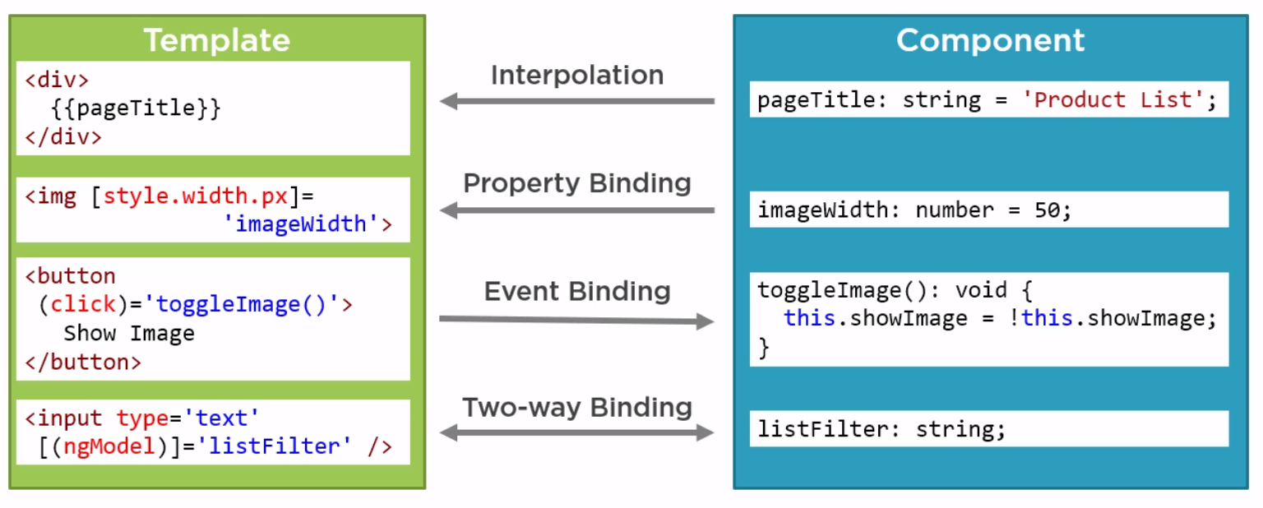
Angular Data Binding
It is the communication between the Typescript code and the HTML template of the Angular Component.
This is important because allows to display dynamic content and interact with the user.
Notes:
‹#›

Slide 17
Angular Data Binding
Output Data.
String Interpolation - It is great tool to output data in the template.
Property Binding - Allows us to change an HTML property.
Input Data.
Event Binding - Allows us to react to user events.
Input and Output Data.
Two-way binding - Allows us to react to user events and output data at the same time.
Notes:
https://www.w3schools.com/bootstrap/bootstrap_ver.asp
‹#›

Slide 18
Agenda
Document Object Model (DOM)
Angular Framework
Angular versioning
First Angular Application
Angular Components
Angular Modules
Angular Project Startup
Bootstrap Framework
First Angular Component
Angular Data binding

Slide 19

Document Object Model (DOM)
The DOM is a browser’s in-memory structure comprised of nodes and objects that represent the web page.
Javascript programs can access and manipulate the DOM to change the web page displayed in the browser.
<html>
<head>
<title>My title</title>
</head>
<body>
<h1>A heading</h1>
<a href=’’>Link text</a>
</body>
</html>
Notes:
‹#›

Slide 20
Angular Directives
Directives are instructions that manipulate the DOM.
There are three types of directives in Angular:
Component Directives
Structural Directives
Attribute Directives
Notes:
‹#›

Slide 21
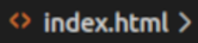
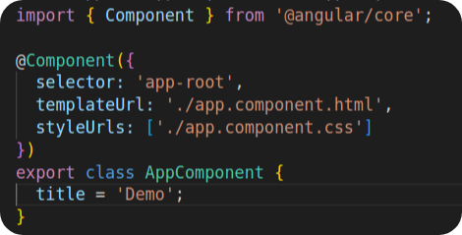
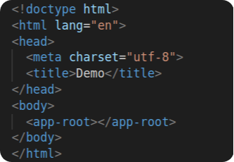
Angular Directives
Component Directives - Angular Components manipulate the DOM because Angular replaces the selector in the HTML page with the content of the component associated to the selector. So components are directives with an HTML template. For example below, the content of the AppComponent replaces the <app-root> tag in the index.html file.
Notes:
‹#›

Slide 22
Angular Directives
Structural Directives - We use these to change the structure of the DOM by adding or removing nodes and objects. They start with an * sign, for example *ngIf ,*ngFor and ngSwitch.
Attribute Directives - Unlike the structural directives, attribute directives don't add or remove elements in the DOM. They only change the element they are placed on. Also, these directives don't use a star in front of their names. For example: ngClass and ngStyle.
Notes:
‹#›

Slide 23
Angular Pipes
We use Pipes to transform data in the HTML template. It’s denoted by the symbol “|” (pipe).
Angular has the following built-in pipes.
lowercase
uppercase
date
currency
json
percent
Syntax: {{ tittle | uppercase }}
Notes:
Examples: <div>
<div>
<h1>Uppercase Pipe</h1>
<b>{{ title | uppercase }}</b>
<br/>
<h1>Lowercase Pipe</h1>
<b>{{ title | lowercase }}</b>
<br/>
<h1>Currency Pipe</h1>
<b>{{ 6589.23 | currency:"USD" }}</b>
<br/>
<b>{{ 6589.23 | currency:"USD":true }}</b>
// Boolean true is used to get the sign of the currency.
<br/>
<h1>Date pipe</h1>
<b>{{ todaydate | date:'d/M/y' }}</b>
<br/>
<b>{{ todaydate | date:'shortTime' }}</b>
<h1>Decimal Pipe</h1>
<b>{{ 454.78787814 | number: '3.4-4' }}</b>
// 3 is for main integer, 4 -4 are for integers to be displayed.
<br/>
<h1<Json Pipe</h1>
<b>{{ jsonval | json }}</b>
<h1>Percent Pipe</h1>
<b>{{00.54565 | percent}}</b>
<h1>Slice Pipe</h1>
<b>{{months | slice:2:6}}</b>
// here 2 and 6 refers to the start and the end index
</div>
</div>
‹#›

Slide 24
Angular Forms
We use Forms to handle the user’s input.
There are two forms types in Angular:
Template-driven forms
Model-driven forms
With a template-driven form, most of the work is done in the template whereas with the model-driven, most of the work is done in the component class (.ts file)
Notes:
‹#›

Slide 25
Angular Routing
We use Pipes to transform data in the HTML template. It’s denoted by the symbol “|” (pipe).
Angular has the following built-in pipes.
lowercase
uppercase
date
currency
json
percent
Syntax: {{ tittle | uppercase }}
Notes:
Examples: <div>
<div>
<h1>Uppercase Pipe</h1>
<b>{{ title | uppercase }}</b>
<br/>
<h1>Lowercase Pipe</h1>
<b>{{ title | lowercase }}</b>
<br/>
<h1>Currency Pipe</h1>
<b>{{ 6589.23 | currency:"USD" }}</b>
<br/>
<b>{{ 6589.23 | currency:"USD":true }}</b>
// Boolean true is used to get the sign of the currency.
<br/>
<h1>Date pipe</h1>
<b>{{ todaydate | date:'d/M/y' }}</b>
<br/>
<b>{{ todaydate | date:'shortTime' }}</b>
<h1>Decimal Pipe</h1>
<b>{{ 454.78787814 | number: '3.4-4' }}</b>
// 3 is for main integer, 4 -4 are for integers to be displayed.
<br/>
<h1<Json Pipe</h1>
<b>{{ jsonval | json }}</b>
<h1>Percent Pipe</h1>
<b>{{00.54565 | percent}}</b>
<h1>Slice Pipe</h1>
<b>{{months | slice:2:6}}</b>
// here 2 and 6 refers to the start and the end index
</div>
</div>
‹#›

Slide 26
Angular HTTP Client
We use Pipes to transform data in the HTML template. It’s denoted by the symbol “|” (pipe).
Angular has the following built-in pipes.
lowercase
uppercase
date
currency
json
percent
Syntax: {{ tittle | uppercase }}
Notes:
Examples: <div>
<div>
<h1>Uppercase Pipe</h1>
<b>{{ title | uppercase }}</b>
<br/>
<h1>Lowercase Pipe</h1>
<b>{{ title | lowercase }}</b>
<br/>
<h1>Currency Pipe</h1>
<b>{{ 6589.23 | currency:"USD" }}</b>
<br/>
<b>{{ 6589.23 | currency:"USD":true }}</b>
// Boolean true is used to get the sign of the currency.
<br/>
<h1>Date pipe</h1>
<b>{{ todaydate | date:'d/M/y' }}</b>
<br/>
<b>{{ todaydate | date:'shortTime' }}</b>
<h1>Decimal Pipe</h1>
<b>{{ 454.78787814 | number: '3.4-4' }}</b>
// 3 is for main integer, 4 -4 are for integers to be displayed.
<br/>
<h1<Json Pipe</h1>
<b>{{ jsonval | json }}</b>
<h1>Percent Pipe</h1>
<b>{{00.54565 | percent}}</b>
<h1>Slice Pipe</h1>
<b>{{months | slice:2:6}}</b>
// here 2 and 6 refers to the start and the end index
</div>
</div>
‹#›

Slide 27
Angular Services
We use Pipes to transform data in the HTML template. It’s denoted by the symbol “|” (pipe).
Angular has the following built-in pipes.
lowercase
uppercase
date
currency
json
percent
Syntax: {{ tittle | uppercase }}
Notes:
Examples: <div>
<div>
<h1>Uppercase Pipe</h1>
<b>{{ title | uppercase }}</b>
<br/>
<h1>Lowercase Pipe</h1>
<b>{{ title | lowercase }}</b>
<br/>
<h1>Currency Pipe</h1>
<b>{{ 6589.23 | currency:"USD" }}</b>
<br/>
<b>{{ 6589.23 | currency:"USD":true }}</b>
// Boolean true is used to get the sign of the currency.
<br/>
<h1>Date pipe</h1>
<b>{{ todaydate | date:'d/M/y' }}</b>
<br/>
<b>{{ todaydate | date:'shortTime' }}</b>
<h1>Decimal Pipe</h1>
<b>{{ 454.78787814 | number: '3.4-4' }}</b>
// 3 is for main integer, 4 -4 are for integers to be displayed.
<br/>
<h1<Json Pipe</h1>
<b>{{ jsonval | json }}</b>
<h1>Percent Pipe</h1>
<b>{{00.54565 | percent}}</b>
<h1>Slice Pipe</h1>
<b>{{months | slice:2:6}}</b>
// here 2 and 6 refers to the start and the end index
</div>
</div>
‹#›

Slide 28
Install
Install Node.js
https://nodejs.org/en/
Update npm
npm install npm@latest –g
npm i -g npm
Install Angular CLI
npm install –g @angular/cli
npm uninstall -g @angular/cli
Update dependencies
npm install -g npm-check-updates
ncu -a

Slide 29
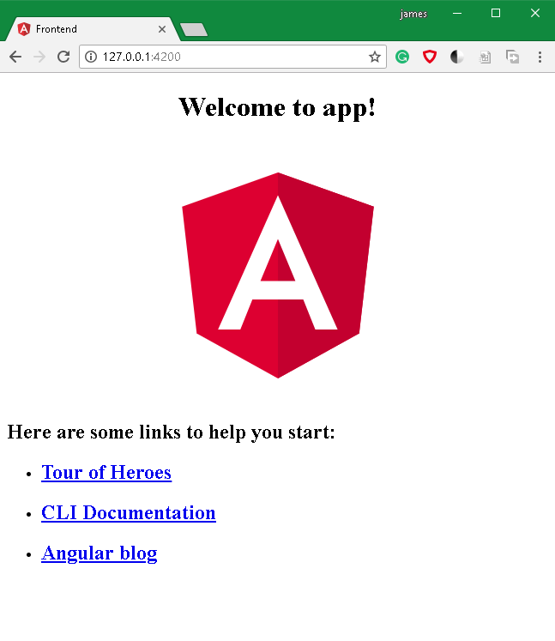
Hello World
Command
ng new my-dream-app
cd my-dream-app
ng serve

Slide 30
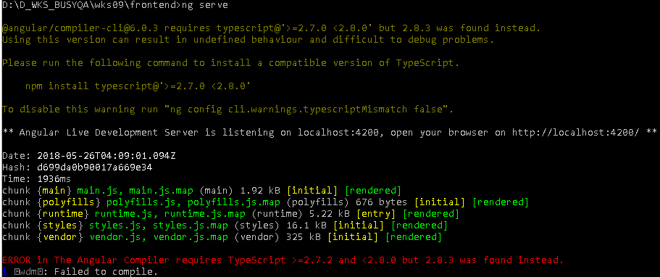
TypeScript Version Error
Check https://github.com/Microsoft/TypeScript/releases
Find the latest version but less than the 2.8.0
Then use “npm install typescript@2.7.2” to install

Slide 31
Visual Studio Code - Plugins
Angular 6 Snippets - TypeScript, Html, Angular Material, ngRx, RxJS & Flex Layout
angular2-inline
Path Intellisense
Bracket Pair Colorizer
Angular Files
Material Icon Theme
Move TS
eclipse keymap
Debugger for Chrome

Slide 32
Keyboard Shortcut
view.explore
workbench.view.extensions
revealFileInOS
workbench.view.debug
workbench.action.splitEditor
extension.switchTS
extension.switchTemplate

Slide 33
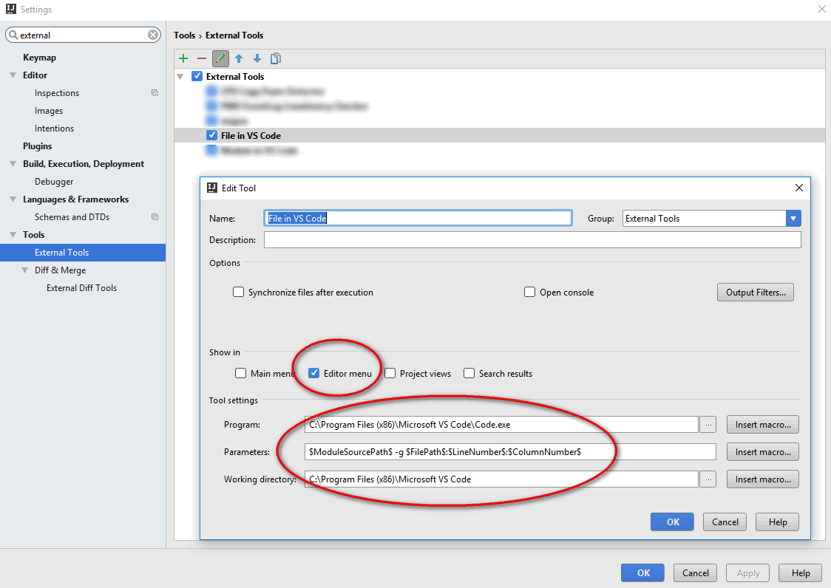
Integration with IntelliJ External Tool
$ModuleSourcePath$ -g $FilePath$:$LineNumber$:$ColumnNumber$

Slide 34
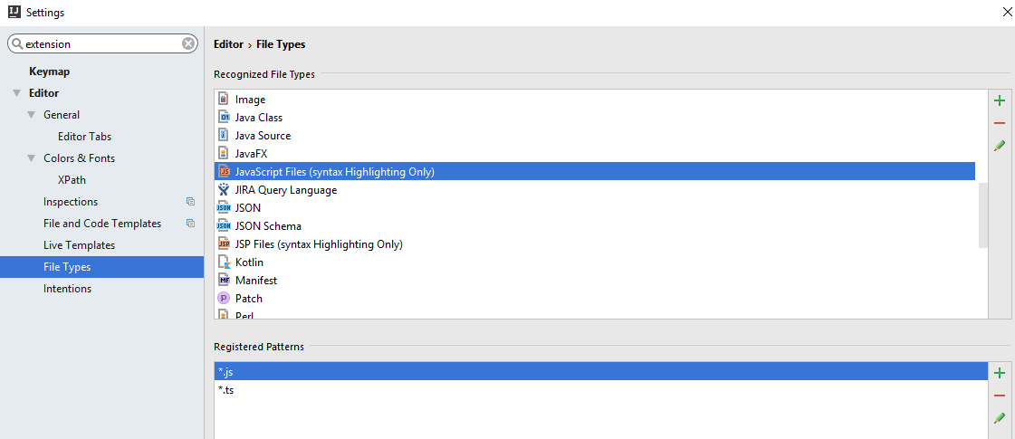
Add File Type

Slide 35
How to Use Example
CMD
D:\D_WKS_BUSYQA\wks09>cd frontend
D:\D_WKS_BUSYQA\wks09\frontend>npm install
…
D:\D_WKS_BUSYQA\wks09\frontend>ng serve
…

Slide 36
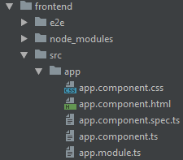
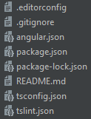
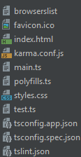
Angular Project
/
/
src
settings
bootstrap
dependencies
common resource (css & index.html)

Slide 37
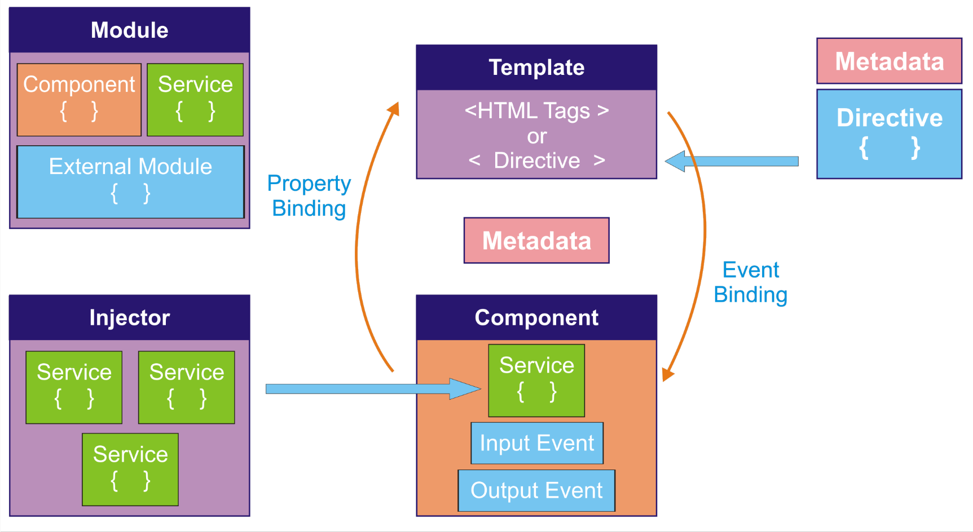
Angular Architecture

Slide 38
app.module.ts: @NgModule
AppModule (Root module): Every Angular application must have it
// a list of the component in this module
declarations: [
AppComponent,
MyComponentComponent,
CapitalizaPipe
],
// define service for injector
providers: [],

Slide 39
app.module.ts: @NgModule
// export and use in another module
exports: [],
// import from other modules
imports: [
BrowserModule,
FormsModule
],
// root component to load into browser
bootstrap: [AppComponent]

Slide 40
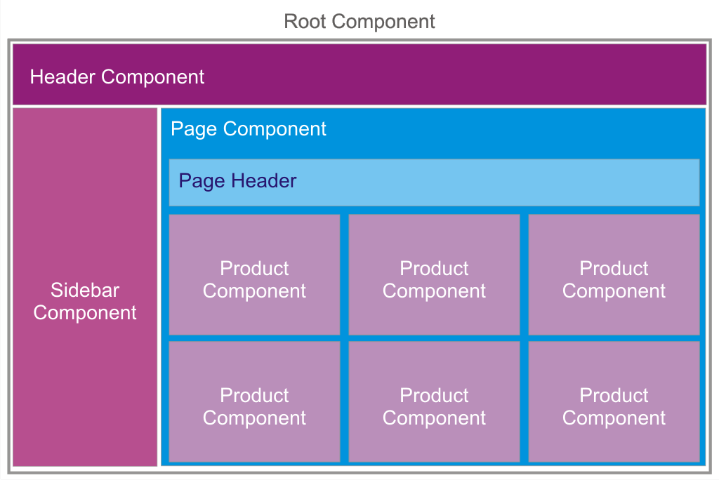
Component

Slide 41
Component
Command
ng generate component [name]
app.module.ts
import { MyComponentComponent } from ‘./[name]/[name].component’;
@NgModule({
declarations: [
MyComponentComponent
],

Slide 42
ng generate component [name]
[name].component.ts
import { Component, OnInit } from '@angular/core';
@Component({
selector: 'app-my-component',
templateUrl: './my-component.component.html',
styleUrls: ['./my-component.component.css']
})
export class MyComponentComponent implements OnInit {
messageValue: string;
constructor() { }
ngOnInit() { }
processString() { }
}
Bean name
View template
Data
Business logic

Slide 43
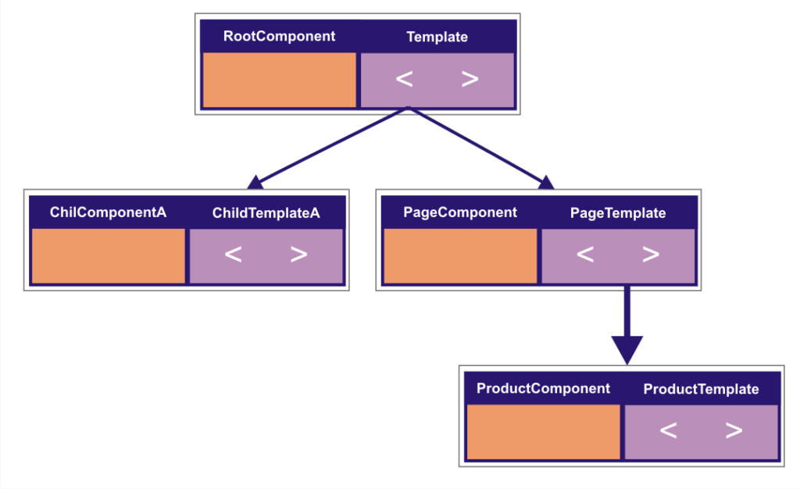
Template Nesting

Slide 44
Template Nesting
app.component.component.html
<app-my-component></app-my-component>
<div style="text-align:center">
…
my-component.component.html
<div>
<input [(ngModel)]="messageValue">
</div>
<p> Hello {{messageValue}}! </p>

Slide 45
Template, Component & Data Bind
[name].component.ts
export class MyComponentComponent implements OnInit {
messageValue: string;
}
[name].component.html
<div>
<input [(ngModel)]="messageValue">
</div>
<p> Hello {{messageValue}}! </p>

Slide 46
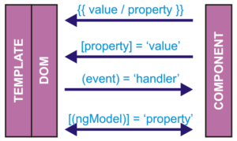
Data Binding
Template
Component
<p> {{messageValue}}! </p>
<input [ngModel]="messageValue"/>
<button (click)="processString('…')”>
<input [(ngModel)]="messageValue"/>
messageValue = '…';
processString(event) {
}

Slide 47
Sharing Data between Components
@Input()
@Output()
@Viewchild()

Slide 48
@Input()
Parent.html
<app-demo-input [inputContent]="'something, something'">
Child.ts
@Input('inputContent') inputContent: string;

Slide 49
@output()
Child.ts
export class DemoOutputComponent {
@Output() outputEvent = new EventEmitter();
triggerOutput() {
this.outputEvent.emit(this.outputConent);}
Parent.html
<app-demo-output (outputEvent)="outputReceiver($event)">
Parent.ts
theOutput;
outputReceiver(receivedContent: String) {
this.theOutput = receivedContent;
console.log(receivedContent);

Slide 50
@ViewChild()
Parent.ts
export class AppComponent {
@ViewChild(DemoViewchildComponent) child;
// child->parent via viewChild
getFromChild() {
this.parentV = this.child.childV;
}
// parent->child via viewChild
sendToChild() {
this.child.childV = this.parentV;
}
Parent.ts
parentV = '…Parent';
Child.ts
childV = 'fromChild';

Slide 51
TypeScript
Type
Type annotations
Interface, Class
Loop

Slide 52
Type
// Number
const decimal: number = 6;
let hex: number = 0xf00d;
let binary: number = 0b1010;
let octal: number = 0o744;
// Stirng
let person: string = 'Mike';
let age = 37;
let sentence: string = `Oh, ${person} is ${age} years old.`;
// Array
let list: number[] = [1, 2, 3];
// Tuple
let x: [string, number];
x = ['hello', 10];
x = [10, 'hello'];
x[3] = true;
// Type Annotation
demoFunction(inputValue: string) {
}

Slide 53
Class & Interface
export interface Shape {
area(): number;
}
export class Circle implements Shape {
static readonly pi = 3.1415;
radius: number;
constructor(radius: number) {
this.radius = radius;
}
area(): number {
return this.radius ** 2 * Circle.pi;
}
}

Slide 54
Loop
const list = [4, 5, 6];
for (let i in list) {
console.log(i); // 0,1,2
}
for (let i of list) {
console.log(i); //4,5,6
}

Slide 55
Angular
Pipes
Routing
Create routing path
Passing parameters
Child route
Navigation
Auth
Module route
Directives
Build-in
Customized an Attribute Directive
Customized a Structural Directive

Slide 56
Pipe
Command
ng generate pipe capitalize
app.module.ts
import { CapitalizePipe } from './capitalize/capitalize.pipe';
@NgModule({
declarations: [
CapitalizePipe
],

Slide 57
Pipe
Template.html
<p>My name is <strong>{{ 'jAMES' | capitalize }}</strong>.</p>
CapitalizePipe
import { Pipe, PipeTransform } from '@angular/core’;
@Pipe({ name: 'capitalize'})
export class CapitalizePipe implements PipeTransform {
transform(value: any, args?: any): any {
// Transfor Logic
return value;
}
}

Slide 58
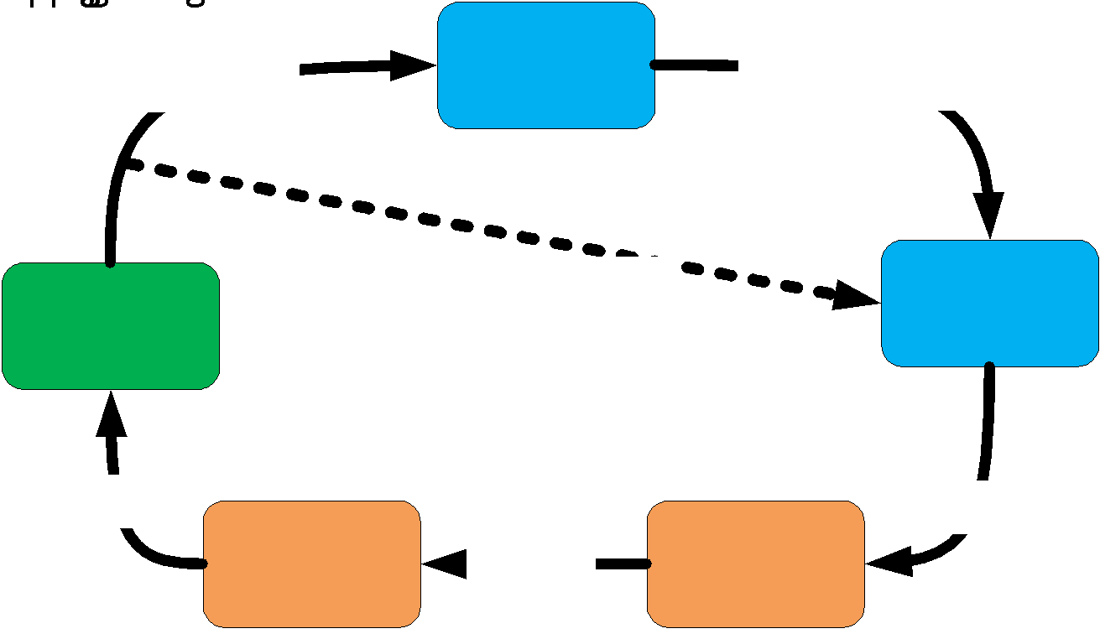
Routing
The Angular router takes a URL, then:
1. Applies redirects 2. Recognizes router states 3. Runs guards and resolves data, 4. Activates all the needed components 5. Manages navigation

Slide 59
Routing
Command (When new a project)
ng new MyProject --routing
Command (After you had a project)
ng generate module NAME_ROUTE --flat --module=app
app.module.ts
import { AppRoutingModule } from './/app-routing.module’;
@NgModule({
imports: [
AppRoutingModule
],

Slide 60
Routing
Template.html
<button routerLink="">Home</button>
<button routerLink="Mine">Mine</button>
<router-outlet></router-outlet>
app-routing.module.ts
const routes: Routes = [
{ path: '', redirectTo: '', pathMatch: 'full' },
{ path: 'Mine', component: MyComponentComponent }
];
@NgModule({
imports: [RouterModule.forRoot(routes)],
exports: [RouterModule]
})
export class AppRoutingModule { }

Slide 61
Route Guards
Command
ng generate guard service/LoggedIn
app.module.ts
import { LoggedInGuard } from './service/logged-in.guard';
@NgModule({
providers: [LoggedInGuard]})
app-route.module.ts
const routes: Routes = [
{ path: 'PostJob', component: JobpostComponent, canActivate:[LoggedInGuard]}
];

Slide 62
Route Guards
logged-in.guard.ts
export class LoggedInGuard implements CanActivate {
canActivate(
next: ActivatedRouteSnapshot,
state: RouterStateSnapshot): Observable<boolean> | Promise<boolean> | boolean {
return true;
}}

Slide 63
Directives
Components:
directives with a template.
Attribute directives:
change the appearance or behavior of an element, component, or another directive.
Structural directives:
change the DOM layout by adding and removing DOM elements.

Slide 64
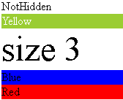
Attribute directives
Template.html
Browser
<div [hidden]="!conditionExp">NotHidden</div>
<div [ngClass]="{'yellow': conditionExp}">Yellow</div>
<div [style.font-size.em]="'3'">size 3</div>
<div [ngStyle]="blueStyle">Blue</div>
<div [ngStyle]="setRedStyle()">Red</div>
css
ts
ts
.yellow{
...
}
blueStyle = {
'background-color': 'blue'
};
setRedStyle() {
return this.redStyles;
}

Slide 65
Customized Attribute directive
highlight.directive.ts
import { Directive, ElementRef, Input } from '@angular/core';
@Directive({selector: '[appHightlightColor]'})
export class HighlightDirective {
@Input('appHightlightColor') appHightlightColor: string;
@Input('defaultColor') defaultColor: string;
constructor(private el: ElementRef) {
this.el.nativeElement.style.backgroundColor = 'red';
}

Slide 66

Customized Attribute directive
highlight.directive.ts
@Directive({
selector: '[appHightlightColor]'
})
export class HighlightDirective {
@Input('appHightlightColor') appHightlightColor: string;
app.module.ts
Template.html
@NgModule({
declarations: [
HighlightDirective
],
<p [appHightlightColor]="color">…</p>
Browser

Slide 67
Attribute directive with HostListener
highlight.directive.ts
import {HostListener} from '@angular/core';
@Directive({selector: '[appHightlightColor]'})
export class HighlightDirective {
@HostListener('mouseenter') onMouseEnter() {
this.highlight('red');
} @HostListener('mouseleave') onMouseLeave() {
this.highlight(null);
} private highlight(color: string) {
this.el.nativeElement.style.backgroundColor = color;
}
}

Slide 68
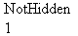
Structural directives
Template.html
<ng-template [ngIf]="conditionExp"><><></ng-template>
<div *ngIf="conditionExp">NotHidden</div>
<div [ngSwitch]="selectionExp">
<ng-template [ngSwitchCase]="1">1</ng-template>
<ng-template ngSwitchCase="2">2</ng-template>
<ng-template ngSwitchDefault>999</ng-template>
</div>
Browser

Slide 69
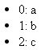
Structural directives
Template.html
<ul>
<ng-template ngFor let-item let-i="index" [ngForOf]="list">
<li>
{{i}}: {{item}}
</li>
</ng-template>
</ul>
<ul>
<li *ngFor="let item of list; let i = index">{{i}}:{{item}}</li>
</ul>
Browser

Slide 70
Customized Structural directives
import { Directive, Input, TemplateRef, ViewContainerRef } from ‘@...’;
@Directive({ selector: '[appUnless]' })
export class UnlessDirective {
constructor(
private templateRef: TemplateRef<any>,
private viewContainer: ViewContainerRef) { }
@Input() set appUnless(condition: boolean) {
if (!condition) {
this.viewContainer.createEmbeddedView(this.templateRef);
} else {
this.viewContainer.clear();
}
}}

Slide 71
Customized Structural directives
unlessdirective.directive.ts
@Directive({ selector: '[appUnless]' })
export class UnlessDirective {
@Input() set appUnless(condition: boolean) {
}}
app.module.ts
Template.html
@NgModule({
declarations: [
UnlessDirective
],
<p *appUnless="condition">…</p>

Slide 72
*: structural directives
#: variable declaration
(): event binding
[]: property binding
[()]: two-way property binding
{{ }}: interpolation

Slide 73
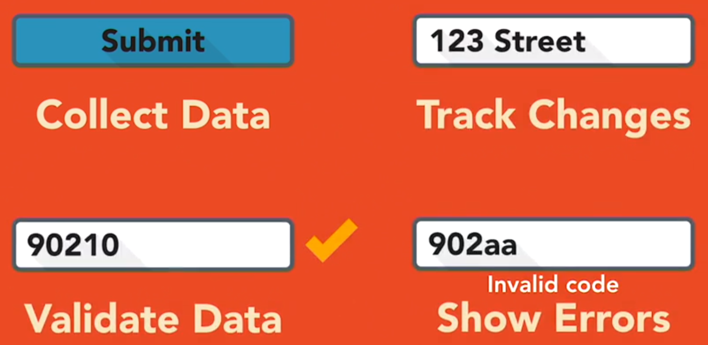
Form Purpose

Slide 74
Angular Form
Template-driven
Model-driven
app.modules.ts
import { FormsModule } from '@angular/forms’;
import { ReactiveFormsModule } from '@angular/forms';
@NgModule({
imports: [
FormsModule,
ReactiveFormsModule
]})

Slide 75
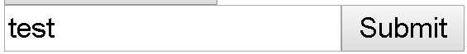
Template-driven Form
Template.html
<form #mf="ngForm" (ngSubmit)="onSubmit(mf)">
<input type="text" name="jsonName" ngModel>
<button type="submit">Submit</button>
</form>
component.ts
browser
export class DemoFormTemplateComponent {
onSubmit(f) {
console.log(f.value);
}
}
console
{jsonName: "test"}

Slide 76

Validation
Template.html
browser
<form #validationForm="ngForm" (ngSubmit)="onSubmit(validationForm)">
<input type="text"
name="someName" #someName="ngModel" ngModel
minlength="2" required/>
<span
[hidden]="someName.pristine || someName.valid">
Warming Msg
</span>
<button type="submit" [disabled]="!validationForm.form.valid">Submit</button>

Slide 77
Other Build-in Validation
CheckboxRequiredValidator
EmailValidator
MaxLengthValidator
MinLengthValidator
PatternValidator
https://www.concretepage.com/angular-2/angular-2-4-pattern-validation-example
RequiredValidator

Slide 78
Model-driven Form
template.html
component.ts
<form [formGroup]="myform">
<fieldset formGroupName="name">
<input … formControlName="firstName">
<input … formControlName="lastName">
</fieldset>
<input … formControlName="email">
<select formControlName="language">
<option> …</option>
</select>
myform: FormGroup;
ngOnInit() {
this.myform = new FormGroup({
name: new FormGroup({
firstName: new FormControl(),
lastName: new FormControl(),
}),
email: new FormControl(),
language: new FormControl()
});
}

Slide 79
Model-driven Validation
template.html
.ts
<form [formGroup]="myform">
<fieldset formGroupName="name">
<input … formControlName="firstName">
<input … formControlName="lastName">
</fieldset>
…
<select formControlName="language">
<option> …</option>
</select>
constructor(private fb: FormBuilder) {
this.myform = this.fb.group({
name: this.fb.group({
firstName: ['', Validators.required],
lastName: ['', Validators.required]
}),
email: ['default', Validators.email],
password: '',
language: 'default value'
});
}

Slide 80
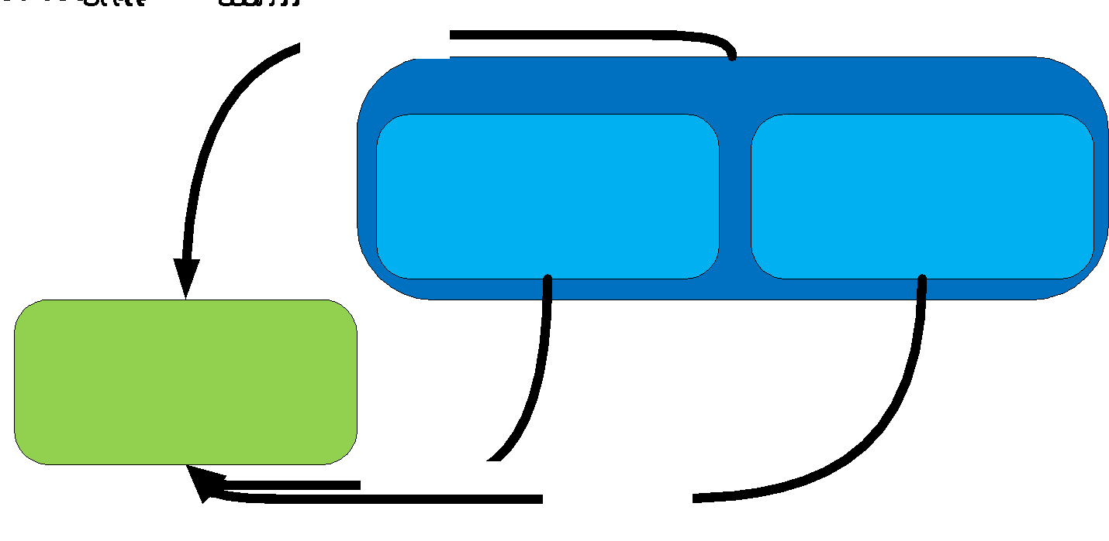
Angular Service and Data Share

Slide 81
Service
app.modules.ts
service.ts
@NgModule({
providers: [DatashareService]
})
import { Injectable } from '@angular/core';
@Injectable()
export class DatashareService {}
constructor() { }}
component.ts
import { DatashareService } from './../service/datashare.service';
export class DemoDatashareSiblingComponent implements OnInit {
constructor(private dService: DatashareService) { }
}

Slide 82
Service
app.modules.ts
service.ts
@NgModule({
providers: [DatashareService]
})
import { Injectable } from '@angular/core';
@Injectable({
providedIn: 'root'
})
export class DatashareService {}
constructor() { }}
component.ts
import { DatashareService } from './../service/datashare.service';
export class DemoDatashareSiblingComponent implements OnInit {
constructor(private dService: DatashareService) { }
}

Slide 83
Passing Data
service.ts
messageSource = new BehaviorSubject<string>('default');
changeMessage(message: string) {
this.messageSource.next(message);
}
component.ts (prepare to receive)
this.dService.messageSource.subscribe(data => this.message = data);
component.ts (sender)
this.dService.changeMessage('changed by sibling');

Slide 84
HTTP Client
app.modules.ts
import { HttpClientModule } from '@angular/common/http';
@NgModule({
imports: [
HttpClientModule,
],
component.ts
import { HttpClient } from '@angular/common/http';
export class DemoHttpclientComponent implements OnInit {
constructor(private http: HttpClient) { }}

Slide 85
Get
component.ts
this.http
.get<JsonExample>('https://jsonplaceholder.typicode.com/posts/2')
.pipe(
retry(3), catchError(this.handleError)
)
.subscribe(
data => {
this.results = data;
}, err => {
console.log('Something went wrong!');
});

Slide 86
Post
component.ts
const postExample = new JsonExample(10, 1000, 'testTitle', 'testBody’);
this.http
.post<JsonExample>('https://jsonplaceholder.typicode.com/posts', postExample)
.subscribe(
data => {
this.results = data;
console.log(this.results);
}, err => {
console.log('Something went wrong!');
});

Slide 87

Any Questions

